Slide 2
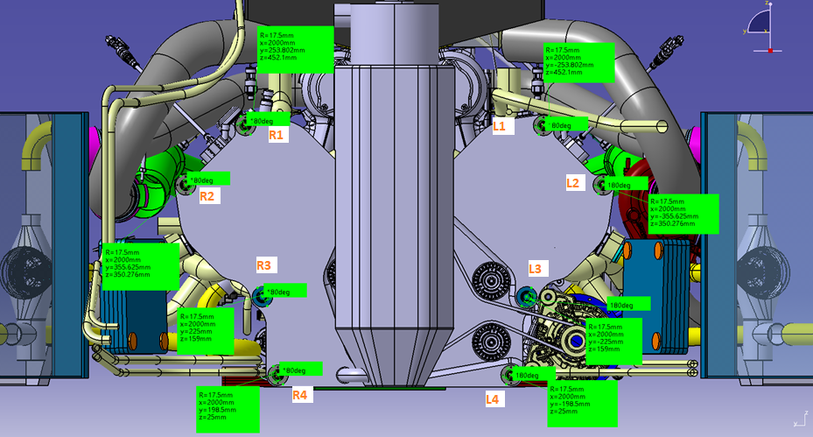
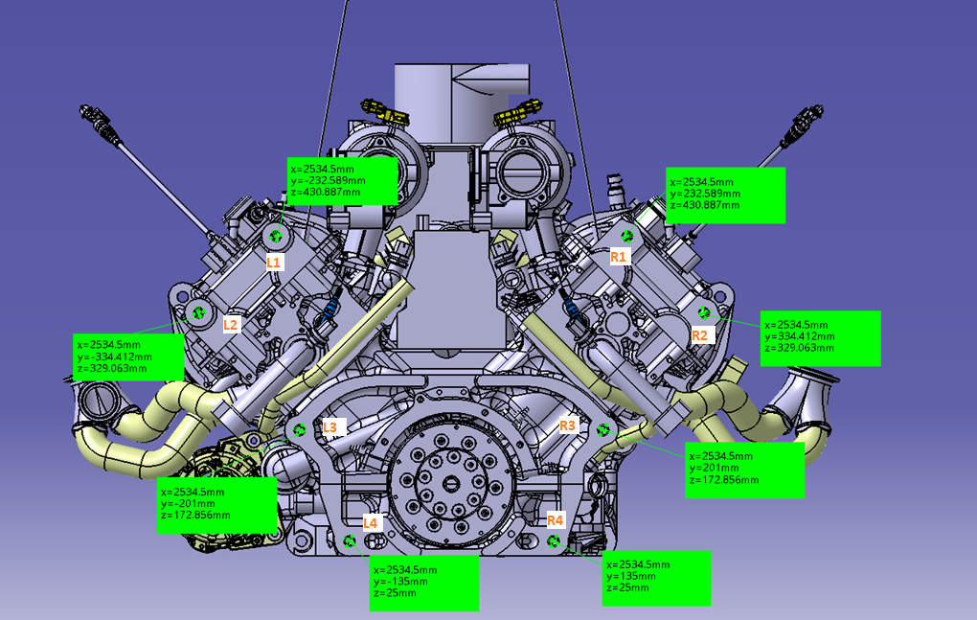
Studs overview
Monocoque to engine studs
Engine to bellhousing studs

Slide 3
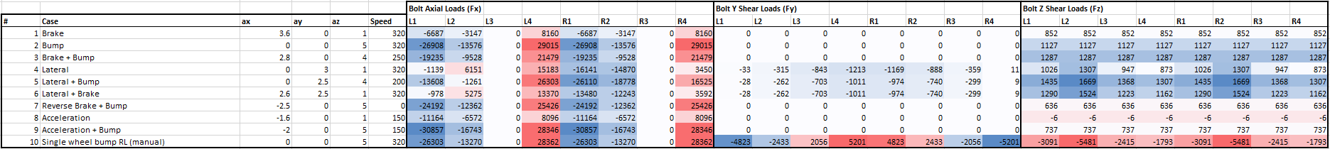
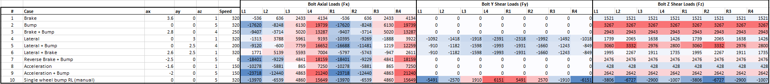
Load cases
Monocoque to engine studs
Engine to bellhousing studs

Slide 4
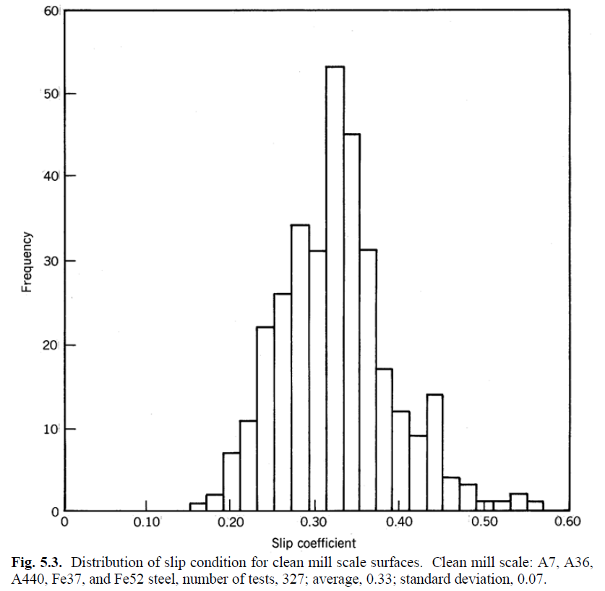
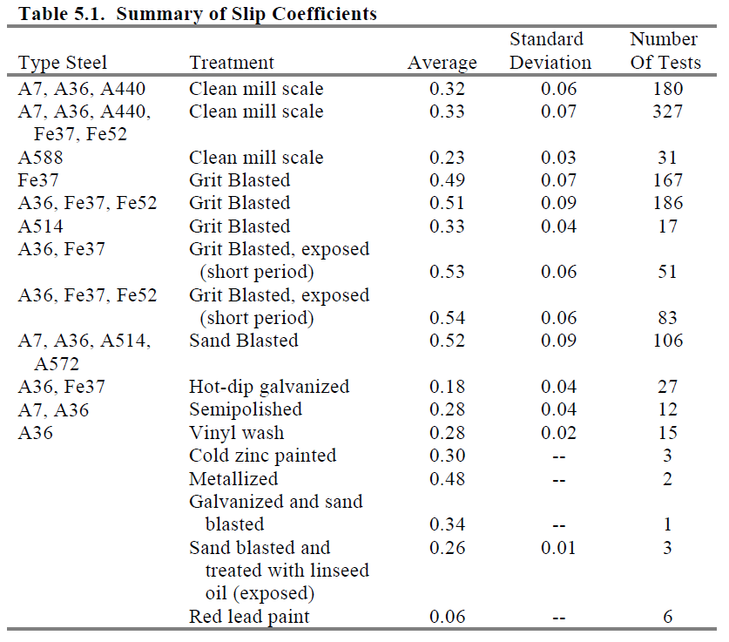
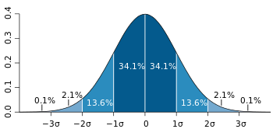
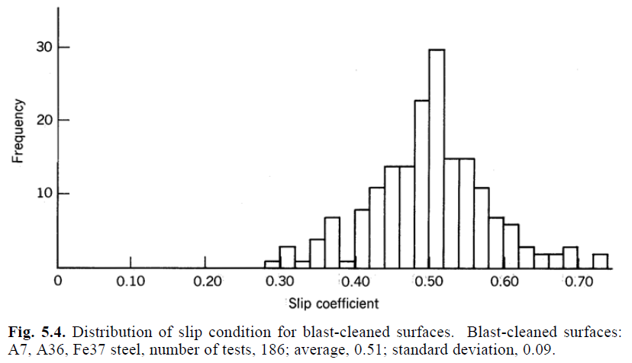

Steel-steel friction coefficient
Chosen friction coefficient
$$f=0.32−2∗0.06=0.2$$
Guide to Design Criteria for Bolted and Riveted Joints (Second Edition)
Geoffrey L. Kulak, John W. Fisher, John H. A. Struik
AMERICAN INSTITUTE OF STEEL CONSTRUCTION, Inc.

Slide 5
Aluminum – aluminum friction coefficient
Not found data of the same quality with respect to steel-steel friction coefficient
0.2 taken as a conservative reference
Table C2
ECSS-E-HB-32-23A
Space engineering - Threaded fasteners handbook

Slide 6
Tightening torque choice flow
Input – loads on studs, thread data, friction coefficients
Minimum required axial load calculation
Tightening torque choice to match the minimum required axial load
Check the clamping condition after external load application and torque uncertainty
OK
NOK
Stud SF check
OK
NOK
Tightening torque validation

Slide 7
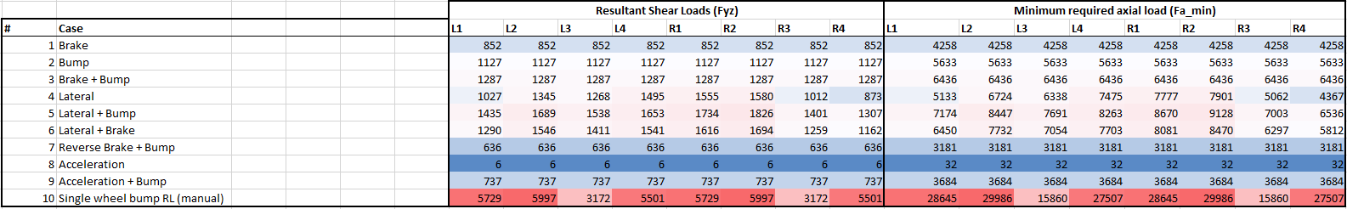
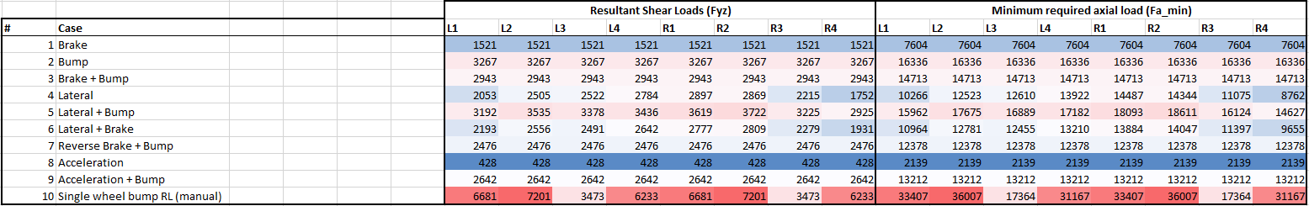

Required axial load computation
Minimum required axial load calculation
$$F_{a_min}=\frac{F_{yz}}{f}$$
Monocoque to engine studs
Engine to bellhousing studs

Slide 8
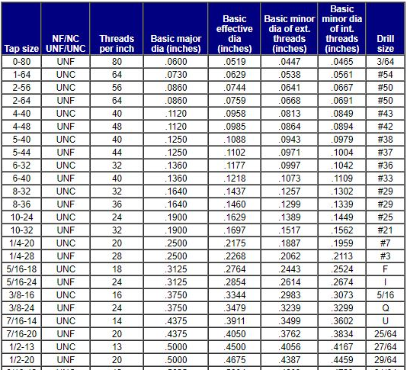
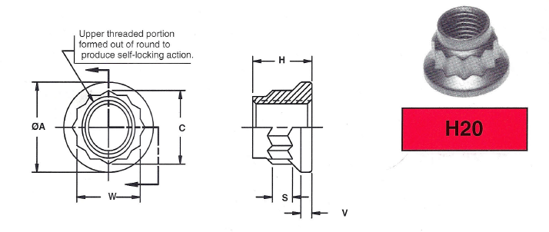
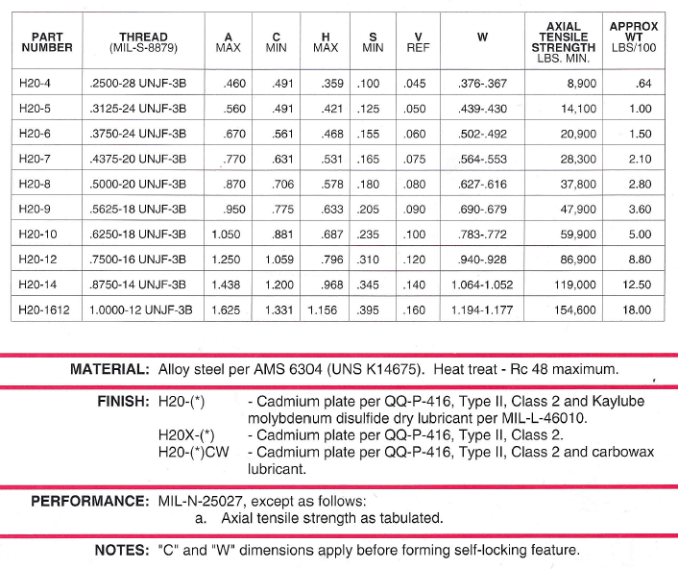
Thread data

Slide 9
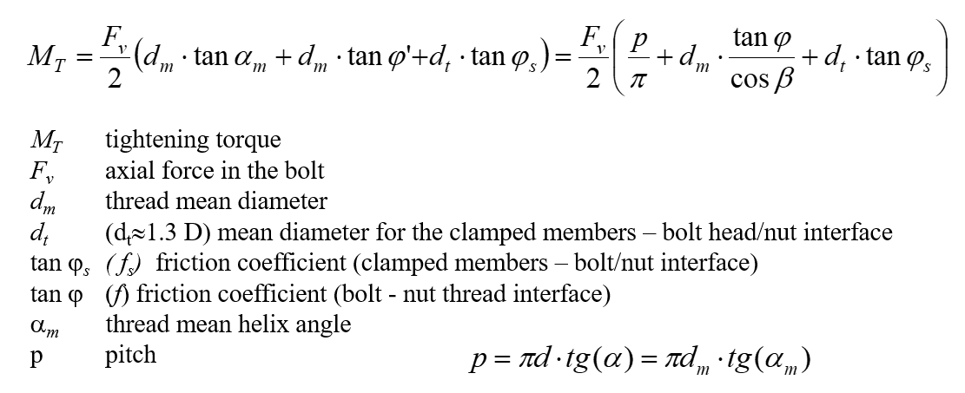
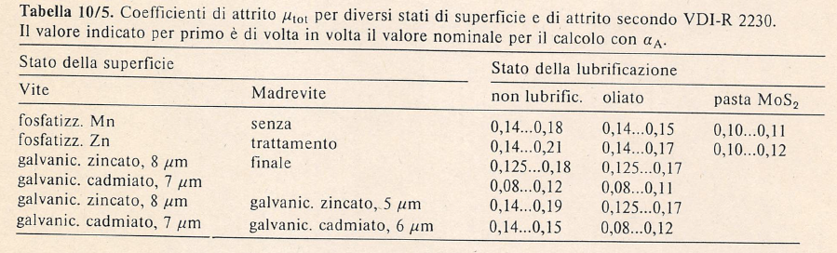
Tightening torque calculation output
Monocoque to engine studs: 90 Nm
Engine to bellhousing studs: 90 Nm

Slide 10
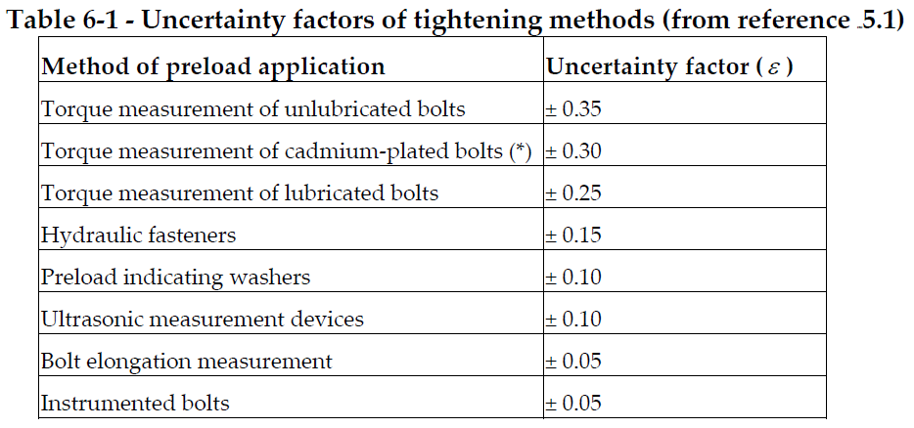
Tightening torque uncertainty
ECSS-E-HB-32-23A
Space engineering - Threaded fasteners handbook
Lower bound
Higher stress due to shear load on the screw
Lower stress due to tightening
Upper bound
Lower stress due to shear load on the screw
Higher stress due to tightening
Worst case scenario

Slide 11
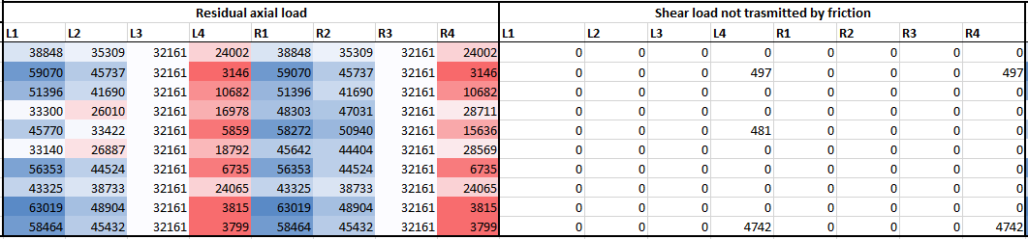
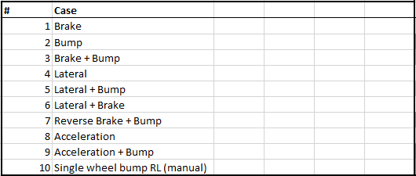
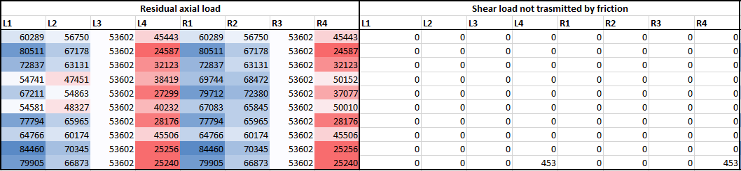
Residual axial load – Monocoque studs
Shear load transmittable by friction – shear load on the stud
Tighening preload lower bound (after torque uncertainty) - Fx
Minimum tightening torque
Tighening preload upper bound (after torque uncertainty) - Fx
Maximum tightening torque

Slide 12
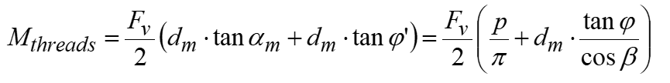
Stud safety factors
Monocoque to engine studs (300 M steel)
Minimum operation SF (max tightening torque): 1.6
Minimum operation SF (min tightening torque): 2.2
Tightening SF: 2.7
Operation SF
Loads: axial preload + peak external tensile load + torque from thread friction + shear load not transmitted by friction (if any) (Von Mises)
Minimum section
Monocoque to engine studs (17-4 PH H900 steel)
Minimum operation SF (max tightening torque): 1.2
Minimum operation SF (min tightening torque): 1.7
Tightening SF: 2.1
Engine to bellhousing studs (300 M steel)
Minimum operation SF (max tightening torque): 1.7
Minimum operation SF (min tightening torque): 2.5
Tightening SF: 2.7
Tightening SF
Loads: axial preload + tightening torque (Von Mises)
Minimum section
Engine to bellhousing studs (17-4 PH H900 steel)
Minimum operation SF (max tightening torque): 1.4
Minimum operation SF (min tightening torque): 1.9
Tightening SF: 2.1

Slide 13
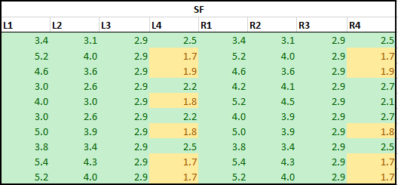
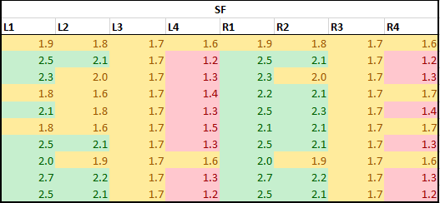
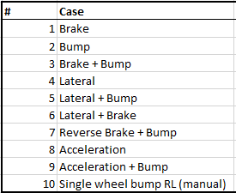
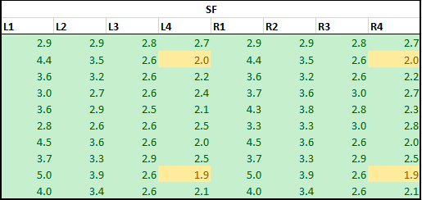
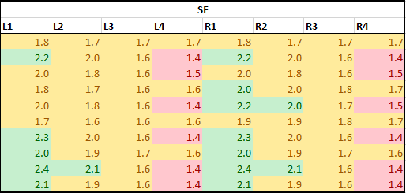
Stud safety factors overview (17-4 PH)
Monocoque to engine studs
Min tightening torque
Max tightening torque
Engine to bellhousing studs
Min tightening torque
Max tightening torque

Slide 14
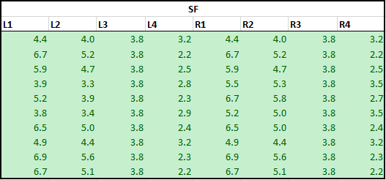
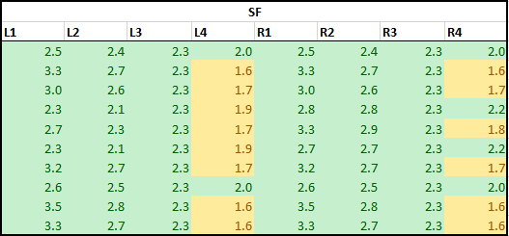
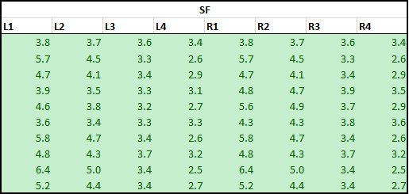
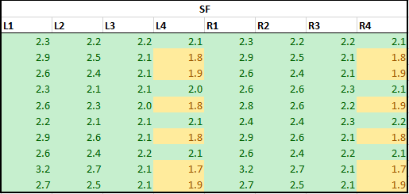
Stud safety factors overview (300 M)
Monocoque to engine studs
Min tightening torque
Max tightening torque
Engine to bellhousing studs
Min tightening torque
Max tightening torque

Slide 15
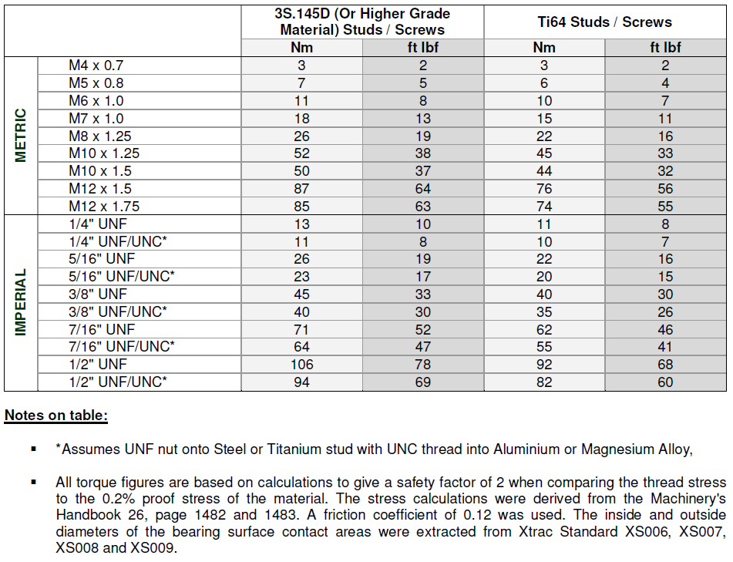
Xtrac reference

Slide 16
Conclusions
Monocoque to engine studs
90 Nm tightening torque
Max axial load under stud nut: 83 000 N
Lubricated threads during installation
Lowering the tightening torque and thus increasing the load carried by friction, the screw safety factor will increase, but the preload on L4 and R4 studs clamped surfaces goes to 0
Engine to bellhousing studs
90 Nm tightening torque
Max axial load under stud nut: 75 000 N
Lubricated threads during installation
Possibility to lower the tightening torque to 85 Nm in order to increase slightly the SF (1.9 with 300M steel)
Not likely to go below 80 Nm, because shear load needs to be transmitted by friction also in L2 and R2 studs (not only L4 and R4) -> difficult to guarantee from a tolerancing point of view
Possible ways to improve the safety factor
Usage of 300 M steel instead of 17-4 PH
Increase the friction coefficients between the clamped components surfaces (eg send blasting), consequently reducing the studs tightening torque

